Slide 1
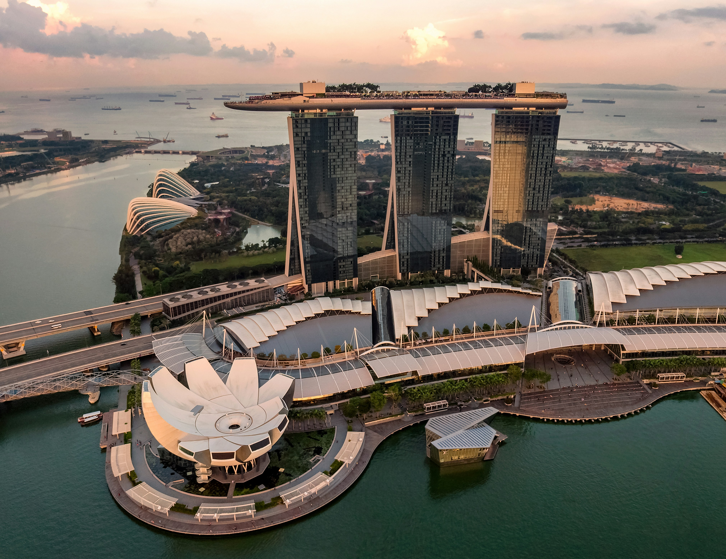
MARINA BAY SANDS, SINGAPORE
LARGEST INFINITY POOL [142 M]
57 STOREY
SKY PARK

Slide 2
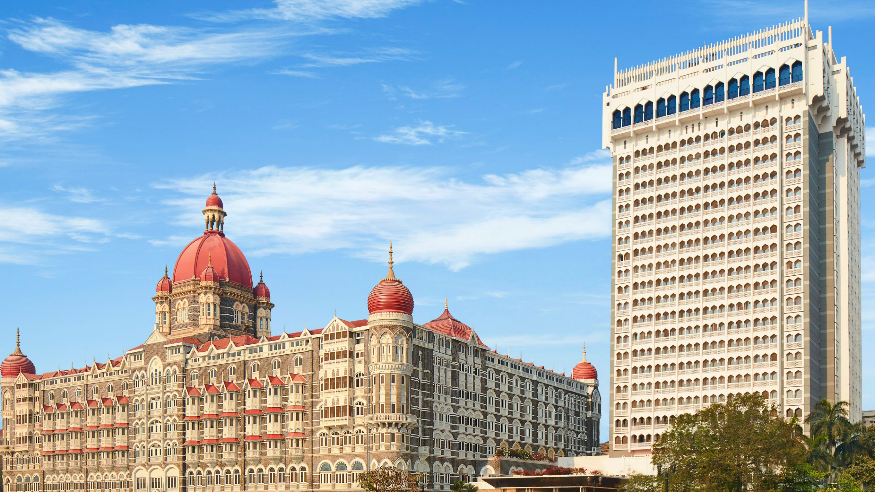
TAJ HOTEL
&
TAJ TOWER

Slide 3
TAJ HOTEL
INDO- SARACENIC ARCHITECTURE
GATEWAY AND FACADES
DOMES AND MINARETS
TAJ HOTEL
&
TAJ TOWER

Slide 4
TAJ TOWER
FITNESS CENTRE
FREE BREAKFAST
POOL
TAJ HOTEL
&
TAJ TOWER

